Slide 1
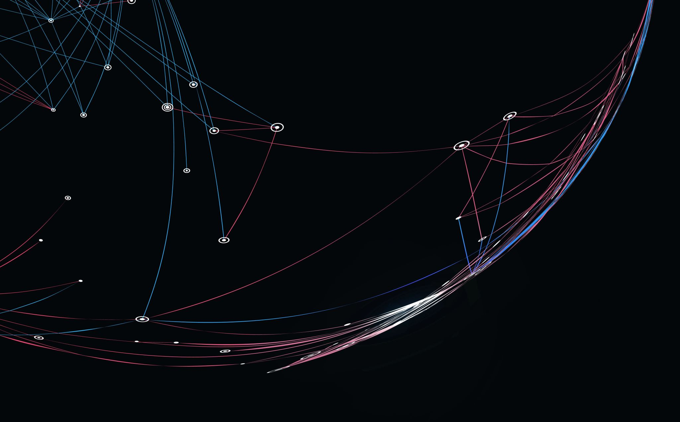
ParkEZ Github Repo
Team 2
Krunal Bhavsar | Shrija Reddy | Tom Alex | Suruchi Patil | Tom Cookson | Ruchi Sharma | Chetan Besnat | Shubham Mittal | Swayambhu Dhuri

Slide 2

GitHub Repo Link
🔗 https://github.com/swayambhu/parkEz

Slide 3



GitHub Repo structure
R1 Documents
Machine Learning
backend
Frontend
Docker-compose.yaml
Jenkinsfile

Slide 4
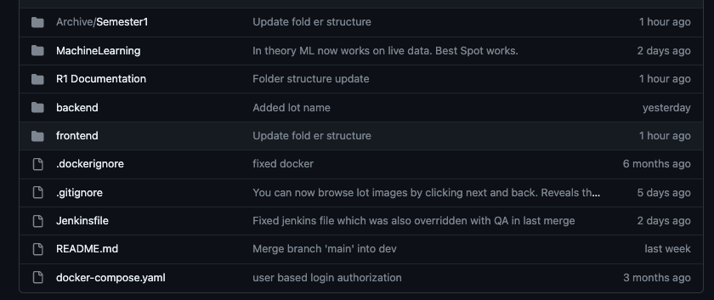
GitHub Repo structure

Slide 5
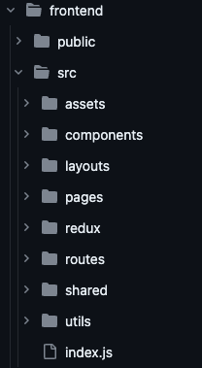
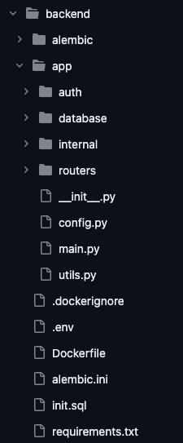
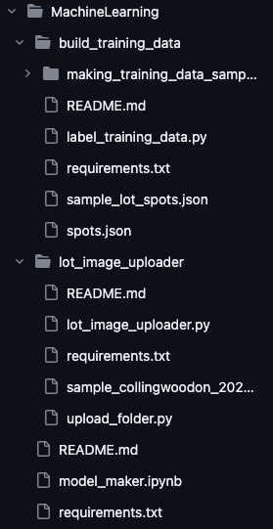
Frontend
backend
Machine Learning

Slide 6

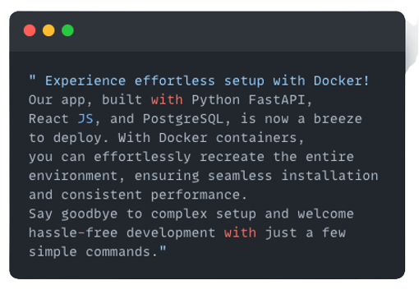

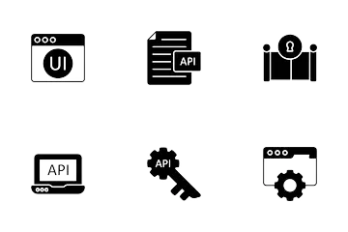
Pre- Requisites

Slide 7





Installation Steps
Clone the GitHub Repo
Download and Install Docker
Open the terminal in the cloned folder.
Run Command
”docker compose build”
Run Command
”docker compose up”
It’s that simple!

Slide 8

Deployment Steps
Add, Commit, and push the changes in git
Jenkins CI/ CD will run the tests and deploy the app
(Jenkins process shown in the further slide)
Deployment will be done automatically by Jenkins

Slide 9
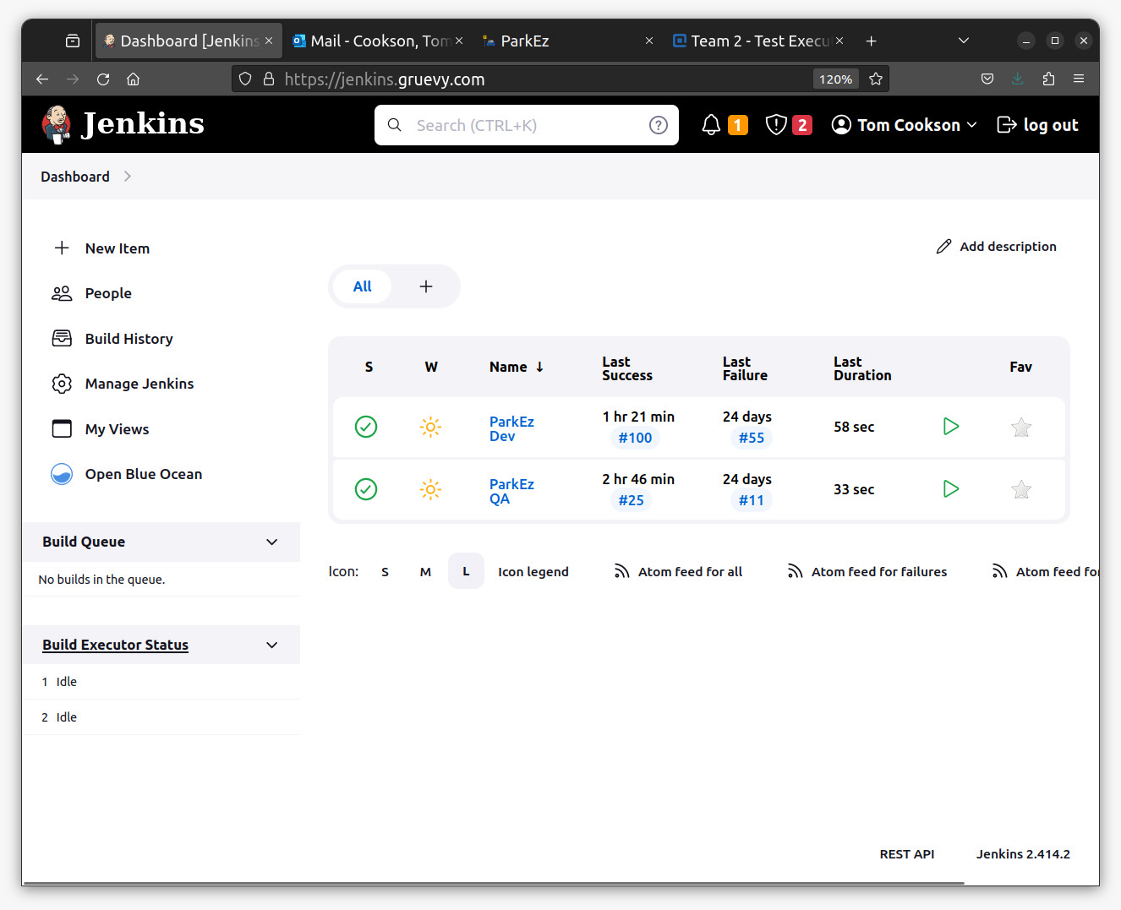
Deployment Steps – Jenkins Environments

Slide 10
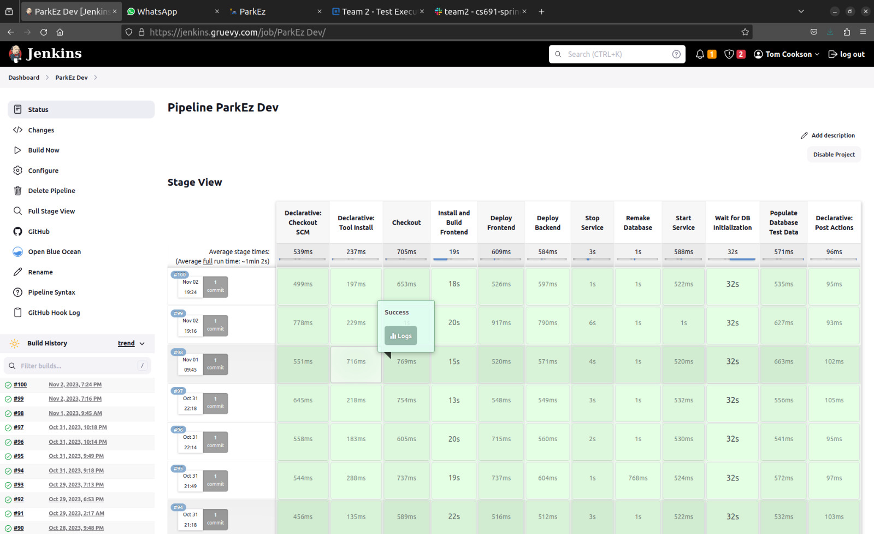
Deployment Steps – Jenkins Dev pipeline

Slide 11
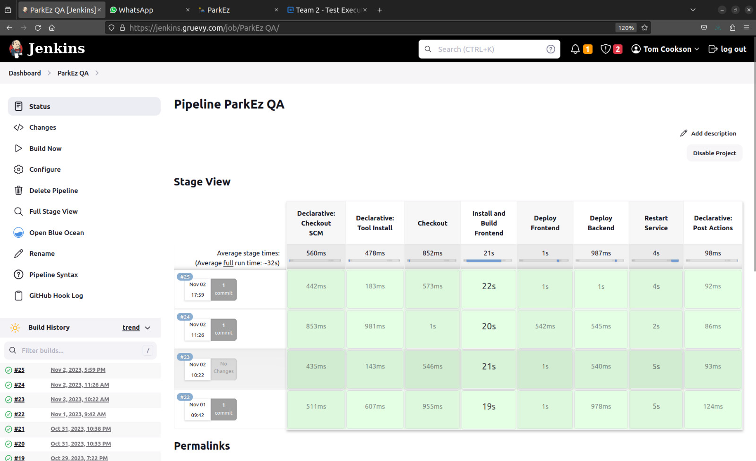
Deployment Steps – Jenkins QA pipeline

Slide 12
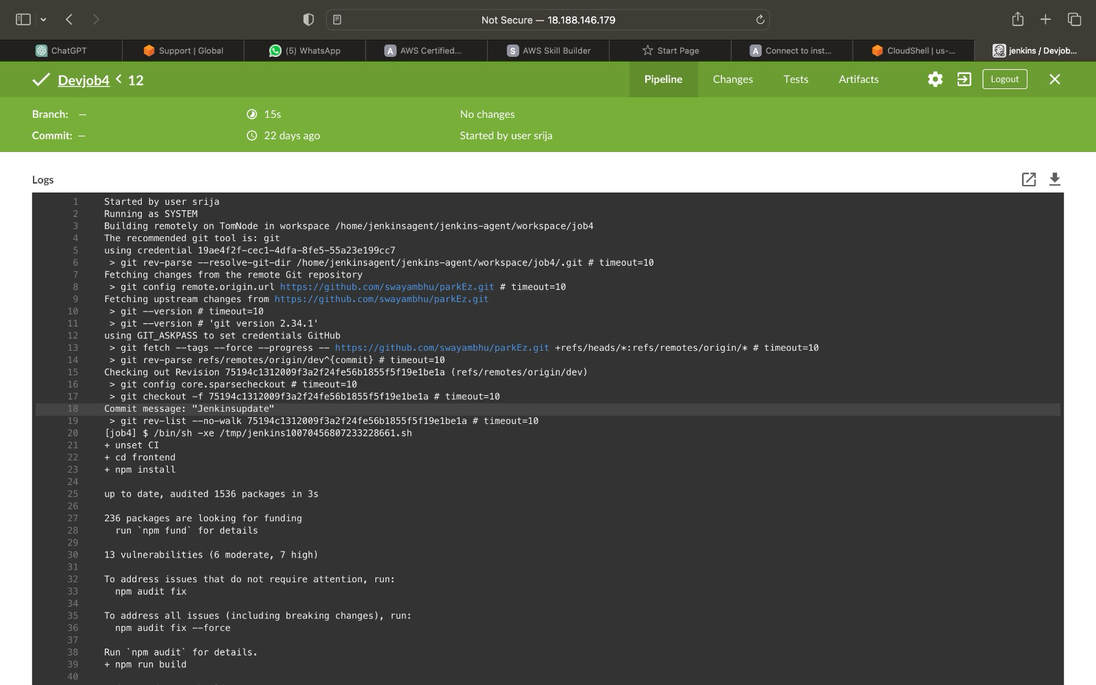
Deployment Steps – Jenkins Logs

Slide 13
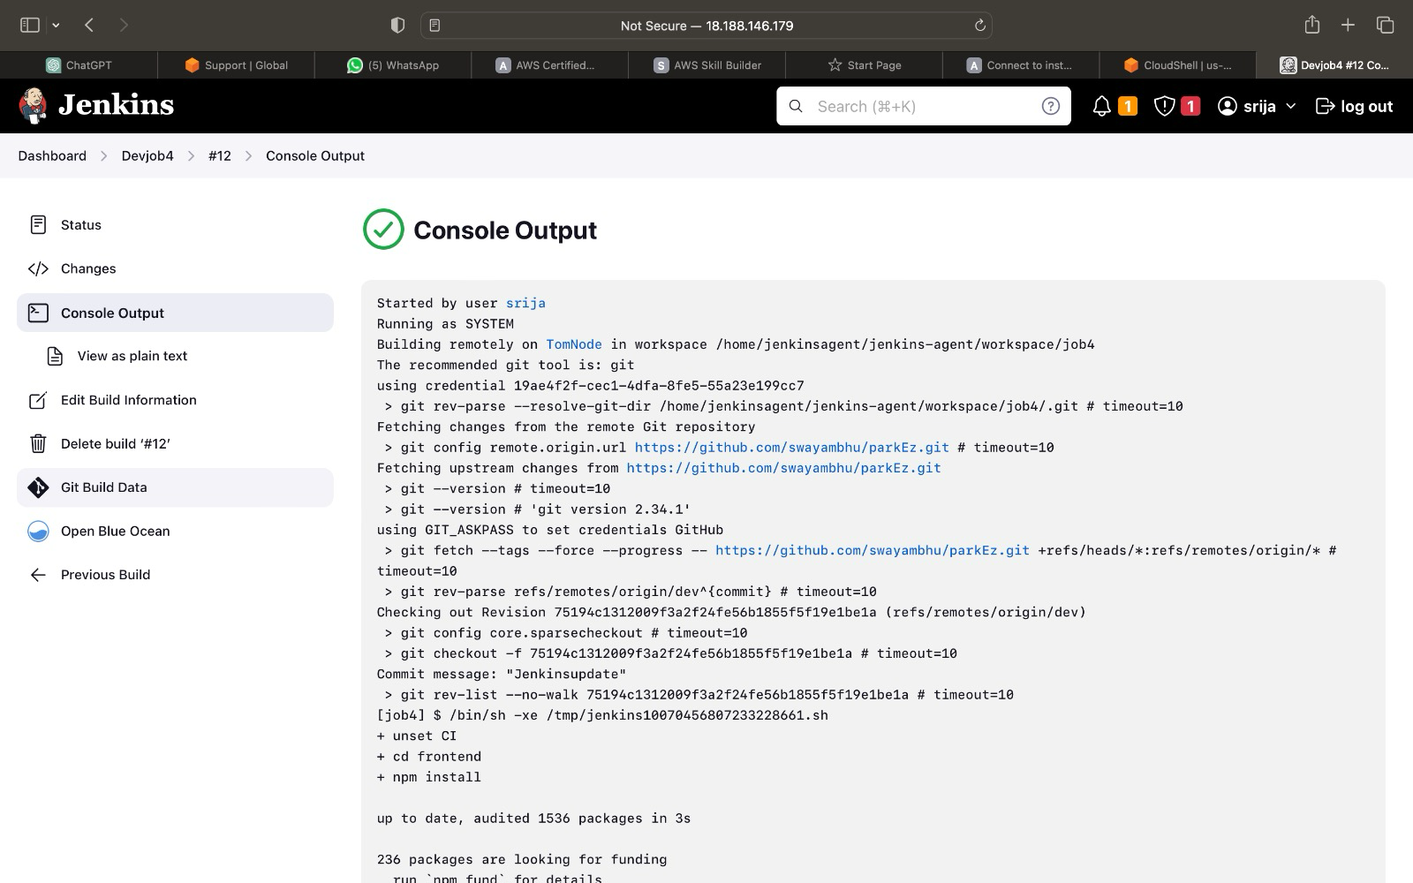
Deployment Steps – Jenkins Deployment Result

Slide 14
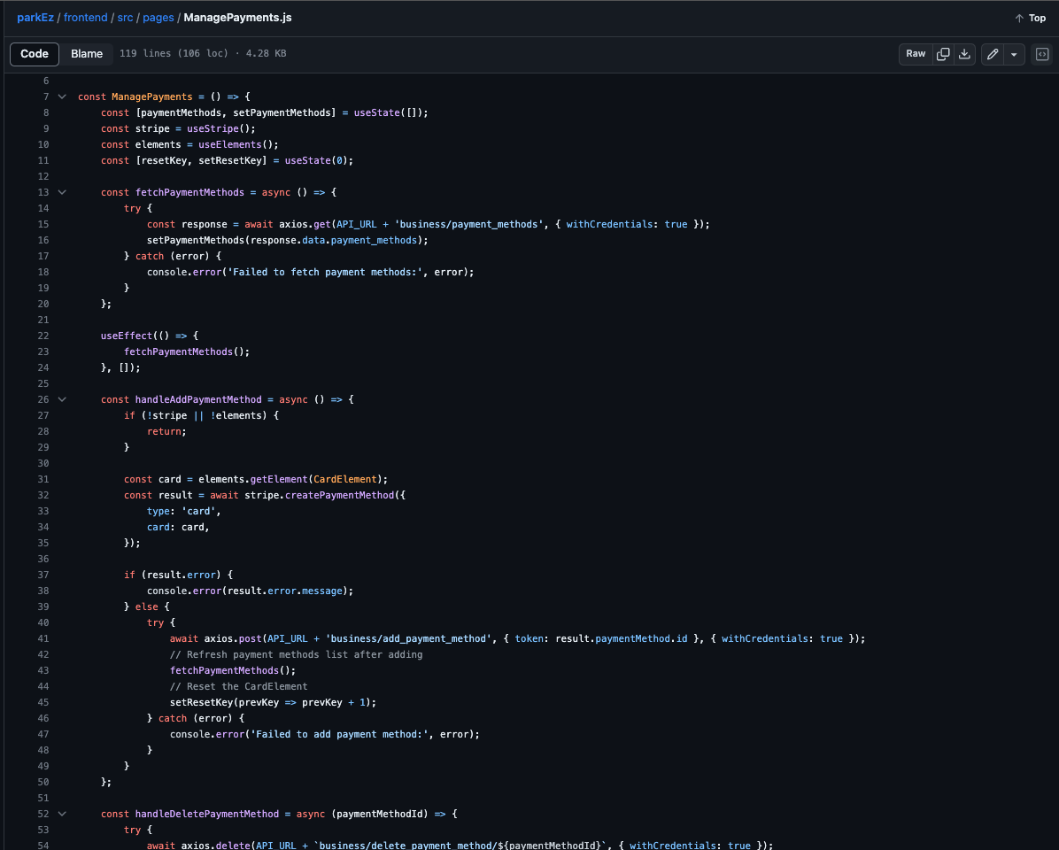
R1 – Iteration 1: Define Payment Method

Slide 15
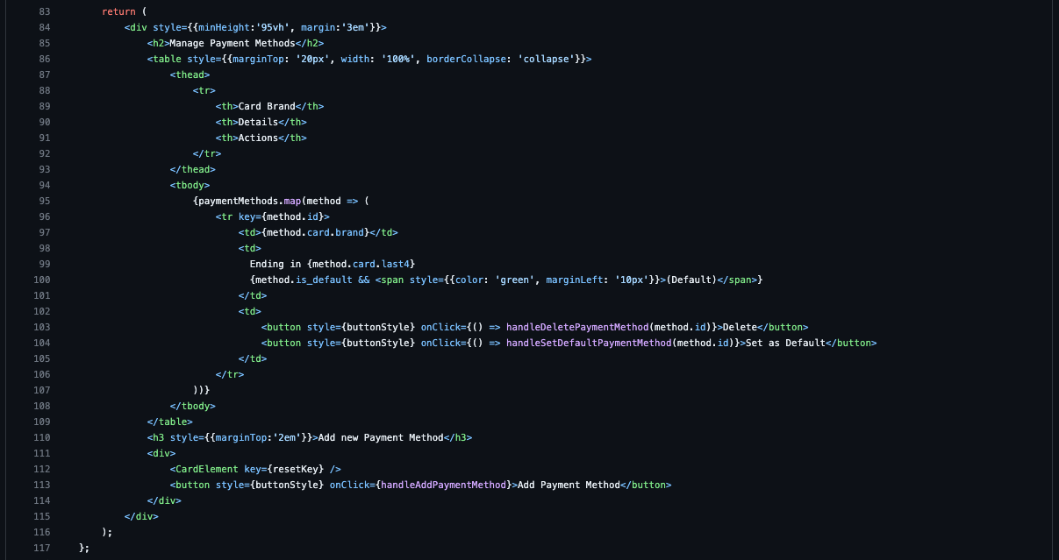
R1 – Iteration 1: Validate Payment

Slide 16
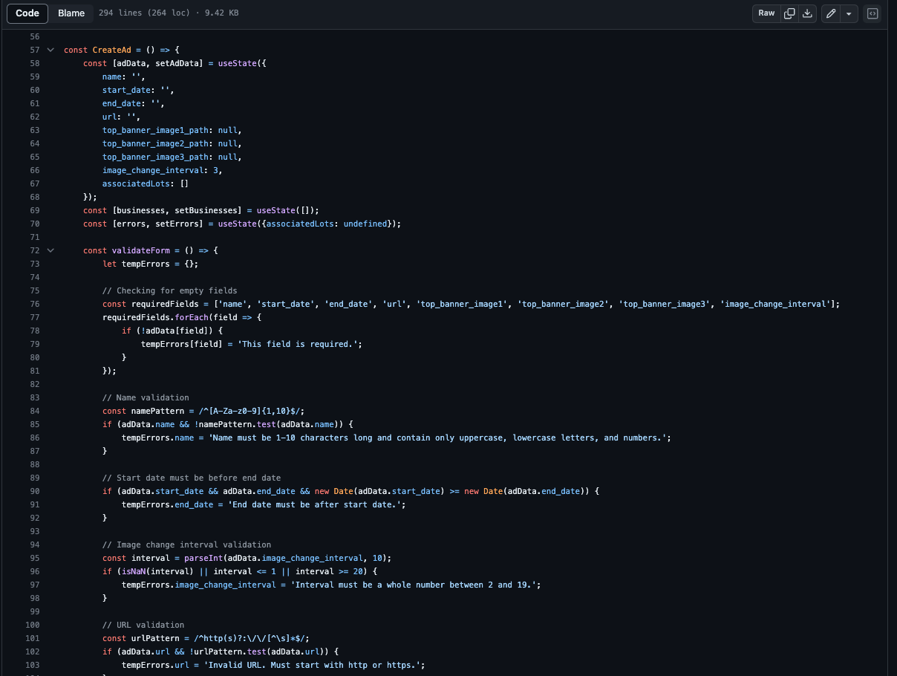
R1 – Iteration 2: Create Ad

Slide 17
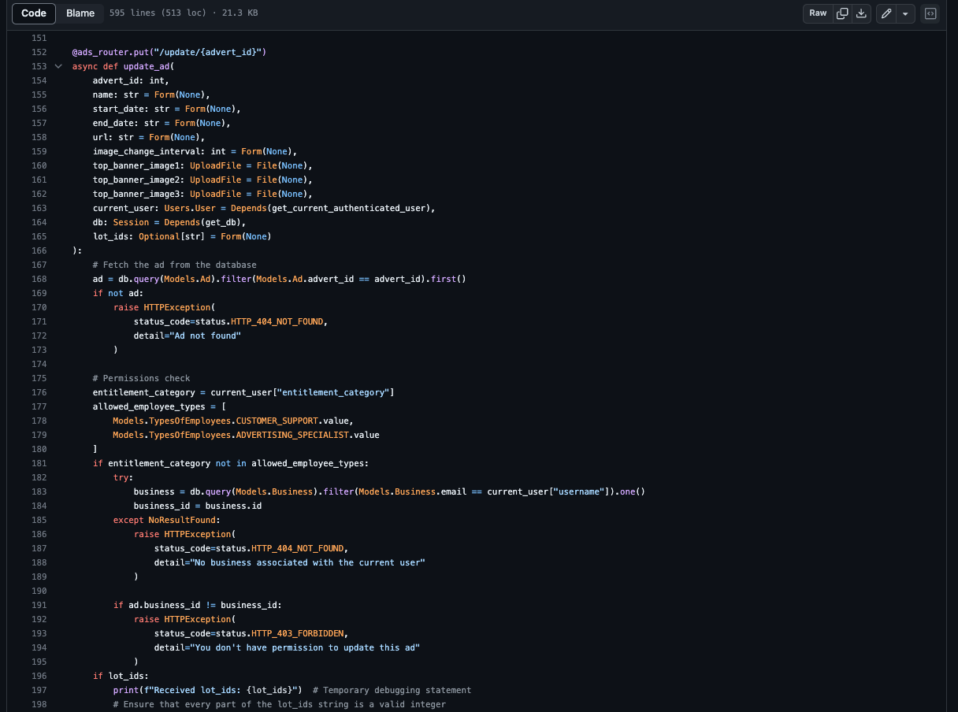
R1 – Iteration 2: Modify Ad

Slide 18
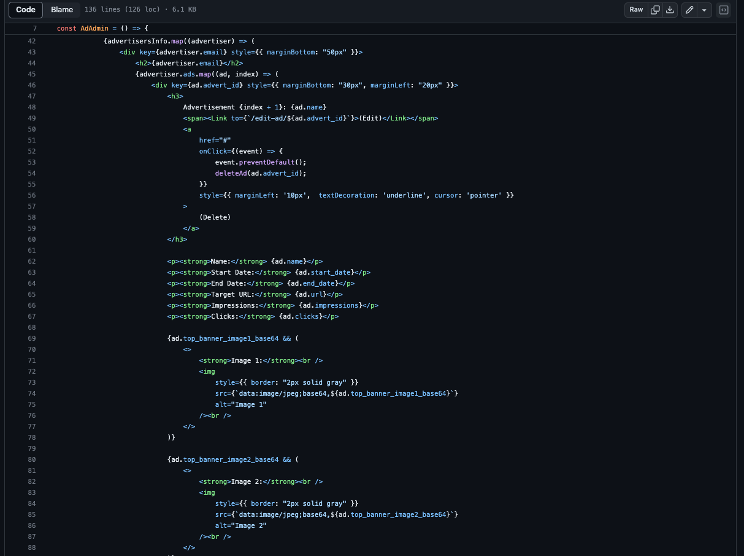
R1 – Iteration 2: View Ad Statistics

Slide 19
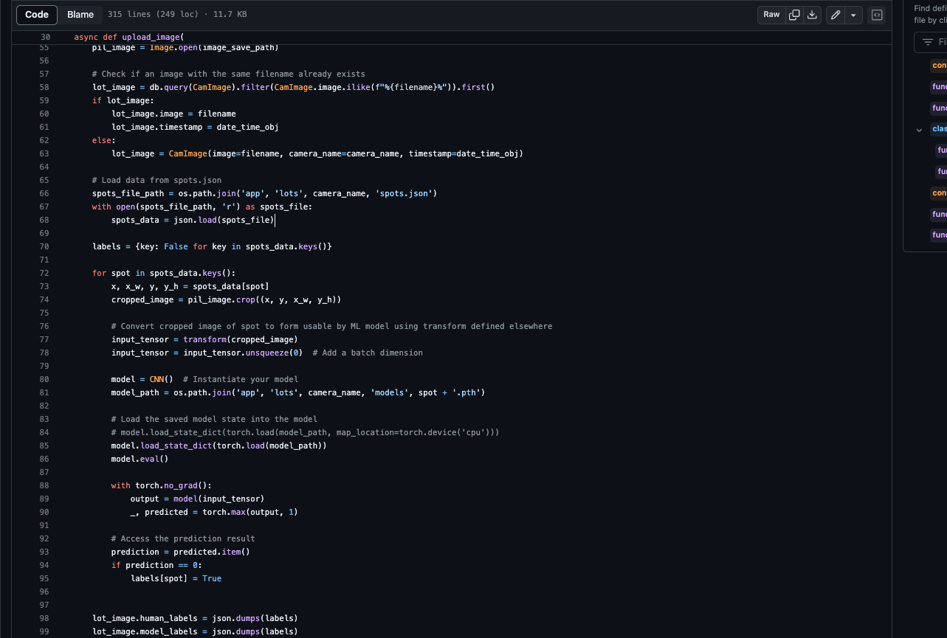
R1 – Iteration 2: Track Occupancy

Slide 20
Thank You

